Slide 1
An Ensemble-Based Machine Learning-Envisioned Intrusion Detection in Industry 5.0-Driven Healthcare Applications
MEMBERS:
R. PRABHU (21BIT042)
K. VIJESH PETHURAM (21BIT058)
GUIDE: DR. T. REVATHI, Senior Prof. & HoD/IT
Department of Information Technology

Slide 2
AIM
To develop an ensemble learning-based intrusion detection system for Industry 5.0 healthcare applications.
To Improve detection accuracy and reduce false alarms by using an ensemble of multiple classifiers.
Department of Information Technology

Slide 3
OBJECTIVES
  To improve the accuracy and reliability of intrusion detection by using Ensemble Learning techniques.
  Evaluate the proposed model's effectiveness using the NSL-KDD dataset to benchmark its performance.
  Perform comprehensive security analysis using Scyther Tool to confirm the robustness of the system.
Department of Information Technology

Slide 4
LITERATURE SURVEY
ML-DDoSnet: IoT Intrusion Detection Based on Denial-of-Service Attacks Using Machine Learning Methods
ADVANTAGES
  The BiLSTM approach demonstrates high accuracy in identifying DDoS attacks in IoT environments, outperforming other models in both binary and multiclass classifications.
  Deep learning-based IDS can dynamically adjust to different attack patterns and data processing techniques, making it suitable for diverse and evolving IoT networks.
LIMITATIONS
  Implementing deep learning models like BiLSTM can be complex and computationally intensive, which may strain resources and affect real-time performance.
  There are ongoing challenges in ensuring effectiveness of BiLSTM across all types of attacks and varying data processing methods.
  M. Esmaeili, S. H. Goki, B. H. K. Masjidi, M. Sameh, H. Gharagozlou,
  and A. S. Mohammed, “ML-DDoSnet: IoT intrusion detection based
  on denial-of-service attacks using machine learning methods and NSLKDD,” Wireless Commun. Mobile Comput., vol. 2022, Aug. 2022,
  Art. no. 8481452.
Department of Information Technology

Slide 5
LITERATURE SURVEY
An adaptive ensemble machine learning model for intrusion detection
ADVANTAGES
  The MultiTree and adaptive voting algorithms achieve high detection accuracy by integrating multiple base classifiers like decision trees, random forests, kNN, and DNN.
  Combines the strengths of various algorithms through ensemble learning, enhancing generalizability and robustness in detecting diverse types of attacks.
LIMITATIONS
  The effectiveness of the model heavily relies on the quality of data features, necessitating further optimization in feature selection and preprocessing.
  The adaptive ensemble learning approach involves adjusting multiple parameters and classifiers, which can increase implementation complexity and computational overhead.
  X. Gao, C. Shan, C. Hu, Z. Niu, and Z. Liu, “An adaptive ensemble
  machine learning model for intrusion detection,” IEEE Access, vol. 7,
  pp. 82512–82521, 2022.
Department of Information Technology

Slide 6
LITERATURE SURVEY
Privacy preserving ensemble infused enhanced deep neural network framework for edge cloud convergence
ADVANTAGES
  Combines ensemble learning with differential privacy to improve deep learning model accuracy and efficiency at edge servers while preserving data privacy.
  Leverages edge computing to handle real-time data processing and reduces bandwidth requirements by offloading some cloud-based tasks to edge devices.
LIMITATIONS
  Despite using differential privacy, the ensemble learning approach may still pose risks of sensitive data leakage when aggregating models from multiple sources.
  Integrating ensemble learning with differential privacy and managing data across multiple institutions can complicate the implementation and maintenance of the model.
  V. Stephanie, I. Khalil, M. S. Rahman, and M. Atiquzzaman, “Privacy preserving ensemble infused enhanced deep neural network framework for edge cloud convergence, ,” IEEE Internet Things J., vol. 10, no. 5,
  pp. 3763–3773, Mar. 2023.
Department of Information Technology

Slide 7
LITERATURE SURVEY
Machine learning and deep learning methods for intrusion detection systems: A survey
ADVANTAGES
  Machine learning and deep learning methods improve detection accuracy and generalizability, enabling effective identification of both known and unknown attacks.
  Provides a detailed classification of IDSs based on data objects, aiding researchers in understanding and applying various machine learning and deep learning techniques.
LIMITATIONS
  Existing IDSs still struggle with issues like false alarms and detecting novel attacks, indicating that current solutions may not fully address all security concerns.
  Developing and maintaining machine learning-based IDSs can be complex due to the need for appropriate algorithms, metrics, and benchmark datasets, which may require substantial expertise and resources.
  H. Liu and B. Lang, “Machine learning and deep learning methods for
  intrusion detection systems: A survey,” Appl. Sci., vol. 9, no. 20, p. 4396,
  Oct. 2019.
Department of Information Technology

Slide 8
LITERATURE SURVEY
DeepFed: Federated Deep Learning for Intrusion Detection in Industrial Cyber–Physical Systems
ADVANTAGES
  Utilizes CNNs and GRUs for improved threat detection and leverages federated learning to build a robust model while preserving data privacy.
  Employs Paillier cryptosystem for secure model parameter exchange and demonstrates effectiveness through real-world testing on industrial CPS datasets.
LIMITATIONS
  Federated learning and deep learning models are challenging to manage and resource-intensive.
  Potential difficulties in scaling across diverse environments and additional computational overhead from cryptographic protocols.
  Li, Beibei & Wu, Yuhao & Song, Jiarui & Li, Tao & Zhao, Liang & Liang, Zhao. (2020). DeepFed: Federated Deep Learning for Intrusion Detection in Industrial Cyber-Physical Systems. IEEE Transactions on Industrial Informatics. 17. 5615 - 5624. 10.1109/TII.2020.3023430.
Department of Information Technology

Slide 9
LITERATURE SURVEY
Malware detection by analysing network traffic with neural networks
ADVANTAGES
  The proposed method can analyze HTTPS traffic to detect malware, leveraging observable data such as host addresses, timestamps, and data volumes, which helps in overcoming the challenge posed by encrypted payloads.
  Utilizes neural language models and LSTM networks, which are well-suited for capturing complex patterns in sequential data, enhancing the accuracy of malware detection.
LIMITATIONS
  The effectiveness of the method relies heavily on the availability of large, labeled datasets, which can be challenging to obtain and manage.
  The method involves sophisticated machine learning models and feature extraction techniques, which may require significant computational resources and expertise to implement and maintain.
  P. Prasse, L. Machlica, T. Pevný, J. Havelka, and T. Scheffer, “Malware
  detection by analysing network traffic with neural networks,” in Proc.
  IEEE Security Privacy Workshops (S&P), 2017, pp. 205–210.
Department of Information Technology

Slide 10
LITERATURE SURVEY
Malicious URL Detection using Logistic
Regression
ADVANTAGES
  The approach directly addresses the challenge of identifying malicious URLs, enhancing its effectiveness in preventing phishing and related attacks.
  Using datasets from PhishTank, Kaggle, and GitHub ensures the model is trained on diverse and reliable data, improving its robustness and accuracy.
LIMITATIONS
  The model may struggle with evolving malicious techniques, requiring frequent updates to stay effective.
  Logistic Regression might not capture complex or subtle patterns as well as more advanced models, potentially limiting detection capabilities.
  R. Chiramdasu, G. Srivastava, S. Bhattacharya, P. K. Reddy, and
  T. Reddy Gadekallu, “Malicious URL Detection using Logistic
  Regression,” in Proc. IEEE Int. Conf. Omni-Layer Intell. Syst. (COINS),
  Barcelona, Spain, 2021, pp. 1–6.
Department of Information Technology

Slide 11
LITERATURE SURVEY
A time sensitive token-based anonymous authentication and dynamic group key agreement scheme for industry 5.0
ADVANTAGES
  The scheme enhances security with anonymous authentication and dynamic group key agreements, addressing issues of anonymity and untraceability.
  Time-sensitive tokens cut down on computational and transmission costs, making the scheme more efficient for IoT environments.
LIMITATIONS
  The use of Blockchain may add complexity and scalability challenges, potentially impacting performance.
  Security validation through mathematical analysis and ProVerif may not cover all real-world scenarios, possibly leaving some vulnerabilities unaddressed.
  Z. Xu, W. Liang, K.-C. Li, J. Xu, A. Y. Zomaya, and J. Zhang, “A time sensitive token-based anonymous authentication and dynamic group key
  agreement scheme for industry 5.0,” IEEE Trans. Ind. Informat., vol. 18,
  no. 10, pp. 7118–7127, Oct. 2022.
Department of Information Technology

Slide 12
LITERATURE SURVEY
A survey on healthcare data security in wireless body area networks
ADVANTAGES
  Provides a detailed analysis of various security measures for WBANs, highlighting recent advancements and effective methodologies.
  Examines data security in the context of specific attack types, ensuring practical relevance and applicability.
LIMITATIONS
  May not fully address the limitations of sensor capabilities, impacting the implementation of security solutions.
  Might overlook new vulnerabilities and emerging threats, leaving some security challenges unaddressed.
  T. Jabeen, H. Ashraf, and A. Ullah, “A survey on healthcare data security
  in wireless body area networks,” J. Ambient Intell. Humanized Comput.,
  vol. 12, pp. 9841–9854, Oct. 2021.
Department of Information Technology

Slide 13
LITERATURE SURVEY
A distance-based method for building an encrypted malware traffic identification framework
ADVANTAGES
  The distance-based method enhances efficiency and accuracy by integrating unsupervised learning (GMM and OPTICS) with supervised learning (XGBoost), leading to better malware identification.
  Defining a new malware class (FClass) based on calculated Distance improves handling of class imbalance and fuzzy boundaries, enhancing classification performance.
LIMITATIONS
  The implementation complexity increases due to the combination of multiple learning algorithms and the new distance metric..
  The method's performance is contingent on the quality and comprehensiveness of the datasets used, which may affect its effectiveness if the data is not representative.
  J. Liu, Z. Tian, R. Zheng, and L. Liu, “A distance-based method for
  building an encrypted malware traffic identification framework,” IEEE
  Access, vol. 7, pp. 100014–100028, 2019.
Department of Information Technology

Slide 14
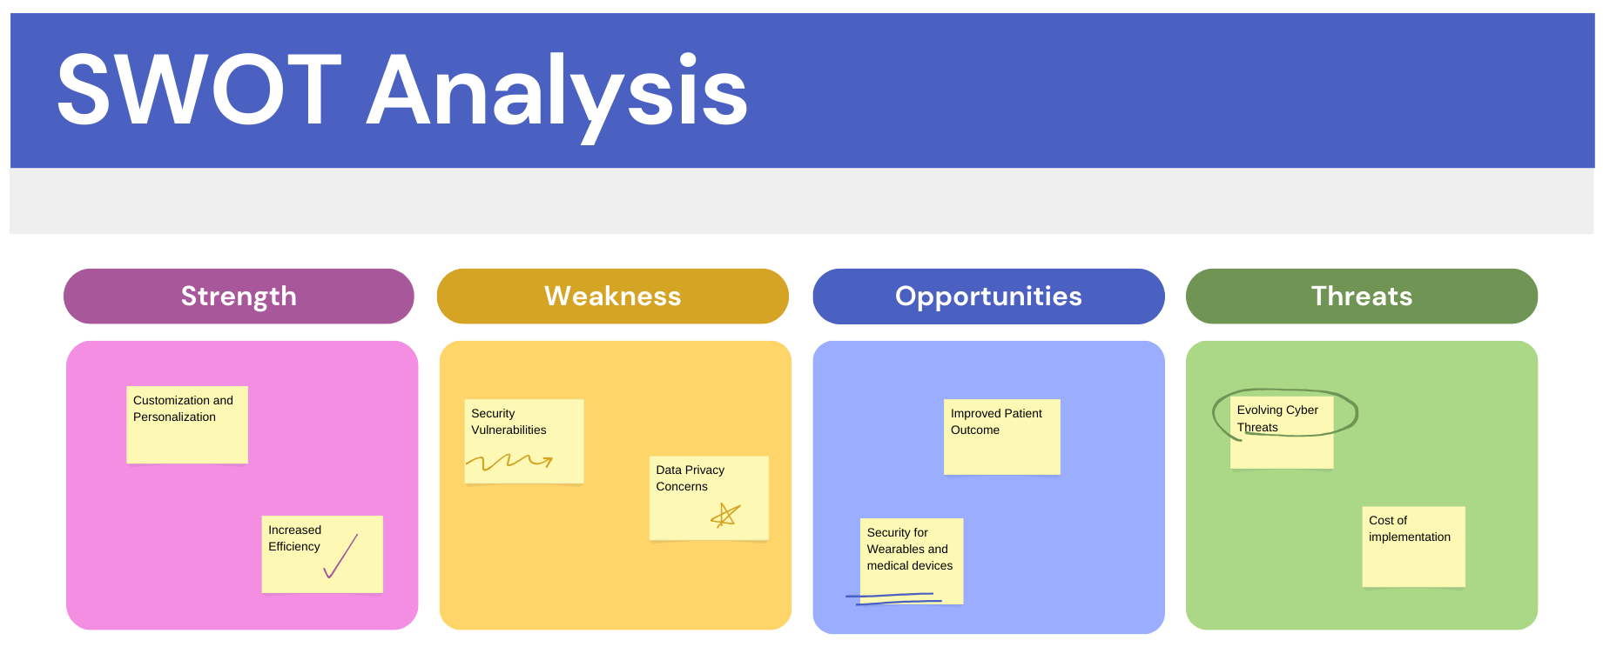
APPLICATION OF DECISION-MAKING TOOLS
Department of Information Technology

Slide 15
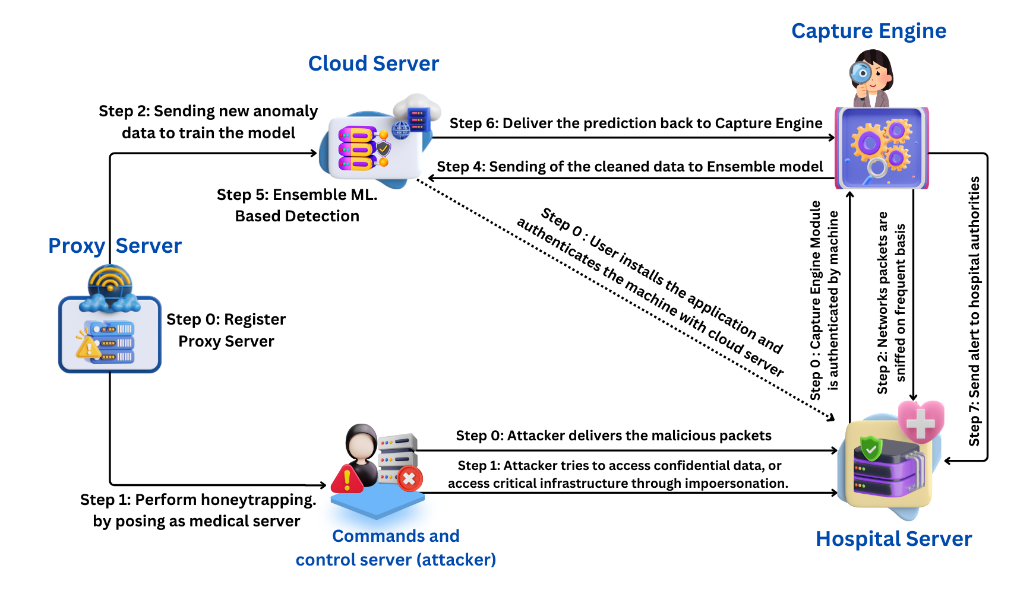
SYSTEM DESIGN
Department of Information Technology

Slide 16
IDENTIFICATION OF CRITERIA FOR EVALUATION OF ALTERNATE DESIGN
  High load on a Central server.
  Bandwidth Consumption.
  Detection Speed.
Department of Information Technology

Slide 17
NOVELTY
  To integrate federated learning with the system.
  Only the model weights and parameters are shared with the central cloud server for aggregation.
  This reduces high load on a centralized server for training and prediction and increases anomaly detection speed.
  This reduces Bandwidth consumption and drastically reduces the costs.
Department of Information Technology

Slide 18
MODULES
Capture Engine Module
Cloud Server
Proxy Server
Hospital Server
Alert and Response Module
Department of Information Technology

Slide 19
CAPTURE ENGINE MODULE
• The Capture Engine is installed and authenticated by the hospital's machine and the cloud server.
• It sniffs the network packets frequently, analyzing them for suspicious patterns or behaviors.
• The captured data, including suspicious network traffic files, is cleaned and sent to the Cloud Server.
Department of Information Technology

Slide 20
CAPTURE ENGINE MODULE
Hospital Server
Capture Engine
Cloud Server
Healthcare Devices & Computers
Department of Information Technology

Slide 21
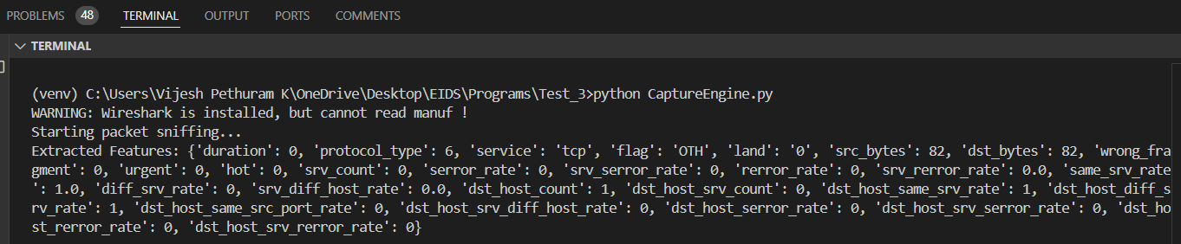
CAPTURE ENGINE MODULE
Department of Information Technology

Slide 22
CLOUD SERVER MODULE
• Receives new malware data or suspicious network traffic data from the Capture Engine to train the detection models.
• Accepts the cleaned data from the Capture Engine for analysis.
• Applies an ensemble machine learning model to analyze the incoming data and detect anomalies, malware, or any malicious activity.
• Sends the detection results back to the Capture Engine.
Department of Information Technology

Slide 23
ALGORITHM-1 (ENSEMBLE MODEL GENERATION)
Input:
A dataset D containing labeled instances,
A parameter k for KNN classifier,
A validation set V of instances
Output:
An ensemble classifier C consisting of SVM, KNN, and DT classifiers, and their weights w1, w2, and w3 respectively
1: for All deployed devices do
2: Split the dataset D into training set T and testing set E.
3: for Each base model type do
4: Train a model M using T.
5: Calculate the accuracy a of M on V.
Department of Information Technology

Slide 24
ALGORITHM-1 (Contd.)
6: Store the model M and its accuracy a in a list L.
7: end for
8: Normalize the accuracy values of the models in L by dividing each a by the sum of all accuracies.
9: Initialize the weights w1, w2, and w3 to be the normalized accuracy values of SVM, KNN and DT classifiers, respectively.
10: for Each instance in V do
11: Obtain the prediction p1 of SVM, p2 of KNN and p3 of DT classifiers.
Department of Information Technology

Slide 25
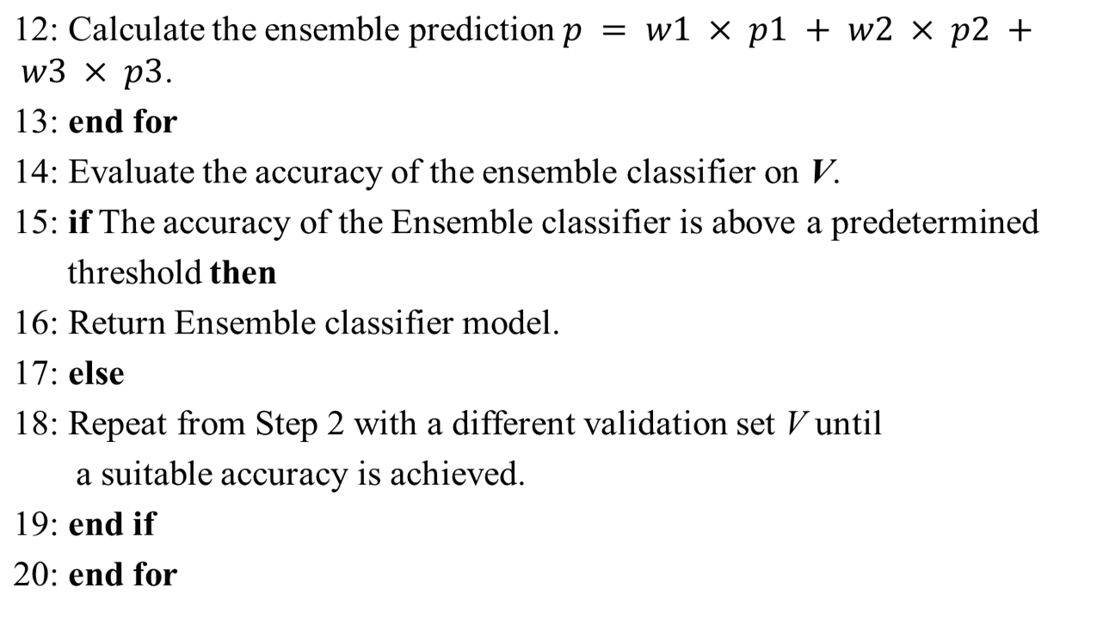
ALGORITHM-1 (Contd.)
Department of Information Technology

Slide 26
ALGORITHM-2 (INTRUSION DETECTION PROCESS)
Input: List of all intrusions
Output: List of detected intrusions
1: for All deployed devices do
2: Load the dataset.
3: Remove duplicate records from the dataset.
4: Separate the dataset into feature matrix X and target variable y.
5: Split the dataset into training and testing sets in a ratio of 70/30.
6: Fit the standard scaler on the training set to normalize.
Department of Information Technology

Slide 27
ALGORITHM-2 (Contd.)
7: Transform the training and testing sets using the fitted scaler.
8: Apply one-hot encoding to the categorical features in X.
9: Apply label encoding for attacks in target variable y.
10: Fit the PCA transformer on the training set.
11: Transform the training and testing sets using the fitted PCA
transformer.
12: Fit the machine learning models on the preprocessed training
set.
13: Evaluate the performance of the trained machine learning
model on the preprocessed testing set.
Department of Information Technology

Slide 28
ALGORITHM-2 (Contd.)
14: Tune the hyperparameters of the model if it is required.
15: if Performance evaluation is done for all deployed machine
learning models then
16: Predict the best performance.
17: else
18: Continue for other deployed machine learning models.
19: end if
20: Prepare a list of intrusions from the detection intrusions.
21: end for
Department of Information Technology

Slide 29
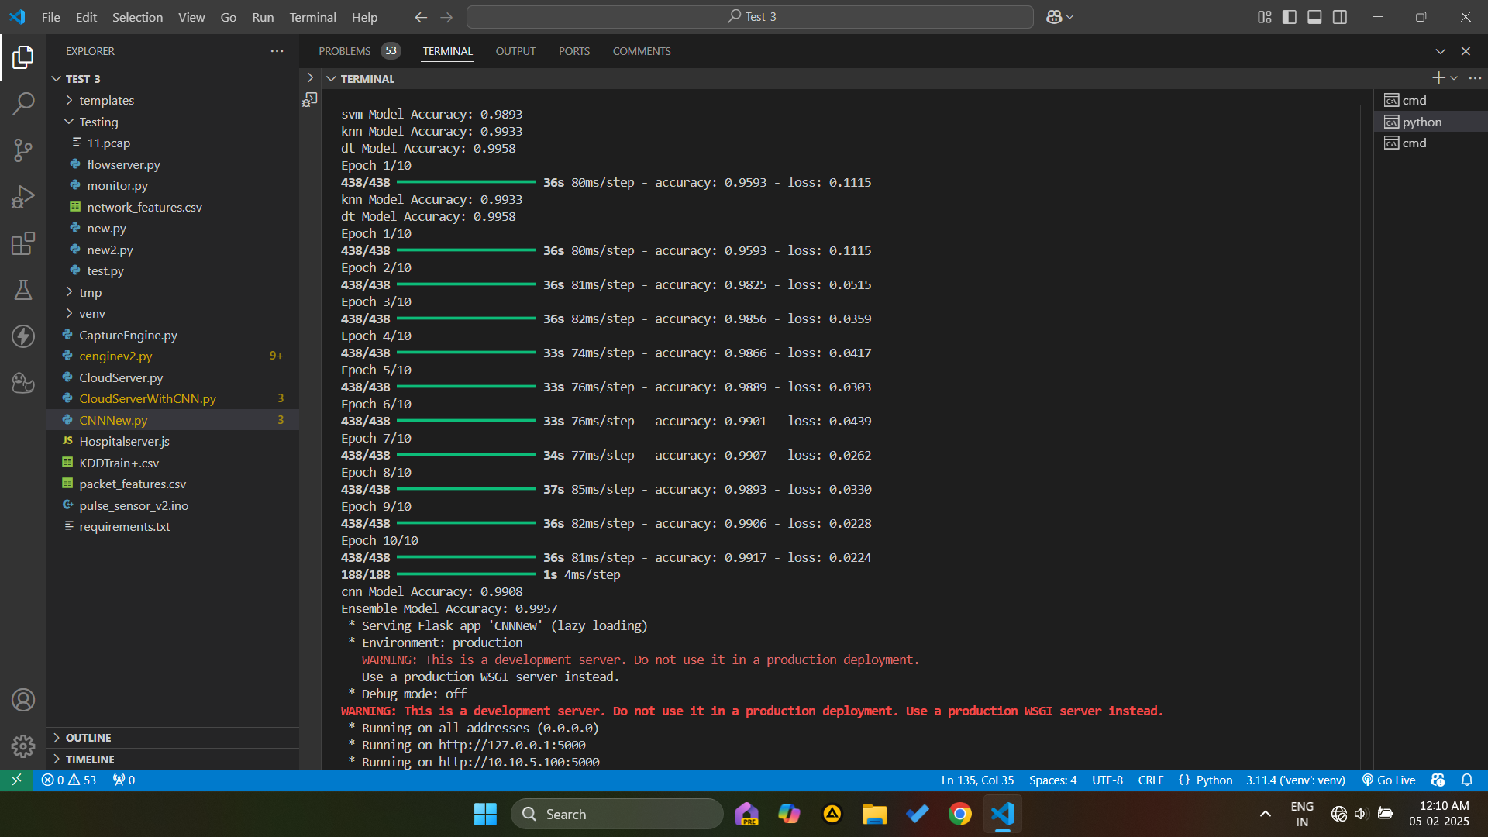
Department of Information Technology

Slide 30
PROXY SERVER
• The Ad-hoc Proxy Module acts as an intermediary or "decoy" that interacts with the attacker, capturing malware and suspicious activities.
• Registers a proxy server that mimics a legitimate medical
server to deceive the attacker.
• Performs "honey trapping," where the proxy server poses as a medical server to collect malware samples from the attacker.
Department of Information Technology

Slide 31
PROXY SERVER
3. Sends attacker info to cloud for training the model
Cloud Server
1. Attacker tries to attack the proxy server
Hospital Server
Attacker
Proxy Server
2. The proxy server provides false information to attacker
4. If the attacker finds out, he may find out and attack the original server
Department of Information Technology

Slide 32
HOSPITAL SERVER
• The Hospital Server Module represents the primary target of the attack and the central point where sensitive data and critical operations are handled.
• Monitor and authenticates communication with the Cloud Server.
• Implements the Capture Engine Module to monitor and report suspicious activities.
Department of Information Technology

Slide 33
HARDWARE REQUIREMENT
Arduino UNO board.
Patient Monitoring devices - Heart rate sensor, Pulse Sensor, etc.
WIFI module to connect the device to IoT.
Department of Information Technology

Slide 34
SOFTWARE REQUIREMENT
SCAPY – A python framework for packet analysis
NPCAP – Packet Analysis Framework
SCIKIT-LEARN – For Machine Learning purpose
SCYTHER – A tool for performing Security Analysis
RENDER – Cloud Platform
Department of Information Technology

Slide 35
DATA SET
NSL-KDD dataset
Available: http://nsl.cs.unb.ca/nsl-kdd/
Department of Information Technology

Slide 36
INPUT/OUTPUT
There are various attributes for input such as the protocol, service, flags, src_bytes, dst_bytes, urgent pointer, etc.
The output is Anomaly packet or Benign packet.
Department of Information Technology

Slide 37
OUTCOME
The proposed methods provide a promising avenue for Intrusion Detection in Healthcare devices.
It can significantly enhance security and strengthen the reliability of Healthcare 4.0 Systems.
Department of Information Technology

Slide 38
THANK YOU
Department of Information Technology

